Slide 1
Schema Refinement and
Normal Forms
Chapter 19
Notes:
1
The slides for this text are organized into chapters. This lecture covers Chapter 19, on formal, dependency-driven database design..
Integrity constraints, in particular functional dependencies, play an important role in the design of database schemas. In particular, they can shed light on potential redundancies (and the problems that go with redundancy) in a relational schema. Typically, they are used to analyze the relational schema obtained by converting an ER diagram.
This chapter can be covered any time after the Foundations material (Chapters 1 to 5) is covered, at the instructor’s discretion. A good choice is to cover it after presenting all the implementation related material that is included in a course. This will allow a design sequence consisting of Chapters 19 and 20, and will enable the instructor to bring out the fact that design involves both redundancy analysis and performance considerations, and that these concerns should go hand-in-hand.

Slide 2
The Evils of Redundancy
Redundancy is at the root of several problems associated with relational schemas:
  redundant storage,
  insert/delete/update anomalies
Main refinement technique:
  decomposition
  Example: replacing ABCD with, say, AB and BCD,
Functional dependeny constraints utilized to identify schemas with such problems and to suggest refinements.
Notes:
14

Slide 3
The Evils of Redundancy
Redundancy is at the root of several problems associated with relational schemas:
  redundant storage,
  insert/delete/update anomalies
Functional dependeny constraints utilized to identify schemas with such problems and to suggest refinements.
Main refinement technique:
  decomposition
  Example: replacing ABCD with, say, AB and BCD,
Decomposition should be used judiciously:
  Is there reason to decompose a relation?
  What problems (if any) does the decomposition cause?
Notes:
14

Slide 4
Insert Anomaly
Student
sNumber | sName | pNumber | pName
s1 | Dave | p1 | prof1
s2 | Greg | p2 | prof2
Question : How do we insert a professor who has no students?
Insert Anomaly: We are not able to insert “valid” value/(s)

Slide 5
Delete Anomaly
Student
sNumber | sName | pNumber | pName
s1 | Dave | p1 | MM
s2 | Greg | p2 | ER
Question : Can we delete a student that is the only student of a professor ?
Delete Anomaly: We are not able to perform a delete without losing some
“valid” information.

Slide 6
Update Anomaly
Student
sNumber | sName | pNumber | pName
s1 | Dave | p1 | MM
s2 | Greg | p1 | MM
Question : How do we update the name of a professor?
Update Anomaly: To update a value, we have to update multiple rows. Update anomalies are due to redundancy.

Slide 7
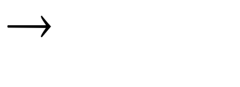
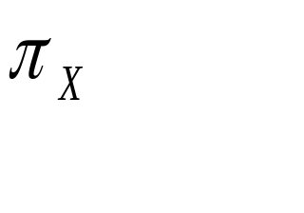
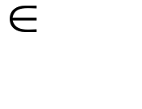
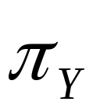
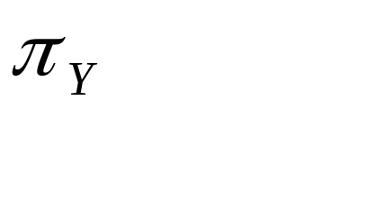
Functional Dependencies (FDs)
A functional dependency X Y holds over relation R if, for every allowable instance r of R:
  t1 r, t2 r, (t1) = (t2)
  implies
  (t1) = (t2)
  Given two tuples in r, if the X values agree, then the Y values must also agree.
Notes:
15

Slide 8
FD Example
Student
sNumber | sName | address
1 | Dave | 144FL
2 | Greg | 320FL
Suppose we have FD sName → address
for any two rows in the Student relation with the same value for sName, the value for address must be the same
i.e., there is a function from sName to address

Slide 9
Note on Functional Dependencies
An FD is a statement about all allowable relations :
  Must be identified based on semantics of application.
Given some allowable instance r1 of R, we can check if it violates some FD f
But we cannot tell if f holds over R!
Notes:
15

Slide 10

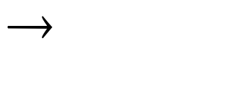
Keys + Functional Dependencies
Assume K is a candidate key for R
What does this imply about FD between K and R?
It means that K R !
Does K R require K to be minimal ?
No. Any superkey of R also functionally implies all attributes of R.
Notes:
15

Slide 11
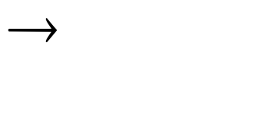
Example: Constraints on Entity Set
Consider relation obtained from Hourly_Emps:
  Hourly_Emps (ssn, name, lot, rating, hrly_wages, hrs_worked)
Notation:
  We denote relation schema by its attributes: SNLRWH
  This is really the set of attributes {S,N,L,R,W,H}.
Some FDs on Hourly_Emps:
  ssn is the key: S SNLRWH
  rating determines hrly_wages: R W
Notes:
16

Slide 12
Problems Caused by FD
Problems due to Example FD :
  rating determines hrly_wages: R W
Notes:
16

Slide 13

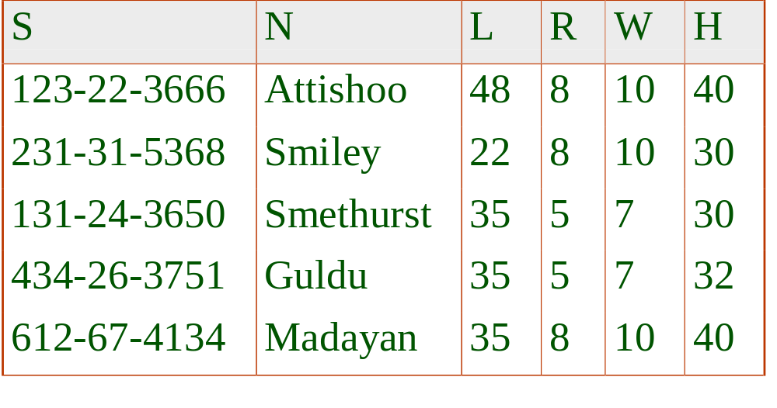
Example
Problems due to R W :
  Update anomaly: Can we change W in just the 1st tuple of SNLRWH?
  Insertion anomaly: What if we want to insert an employee and don’t know the hourly wage for his rating?
  Deletion anomaly: If we delete all employees with rating 5, we lose the information about the wage for rating 5!
rating (R) determines hrly_wages (W)
Hourly_Emps
Notes:
17

Slide 14
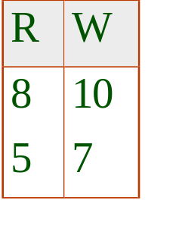
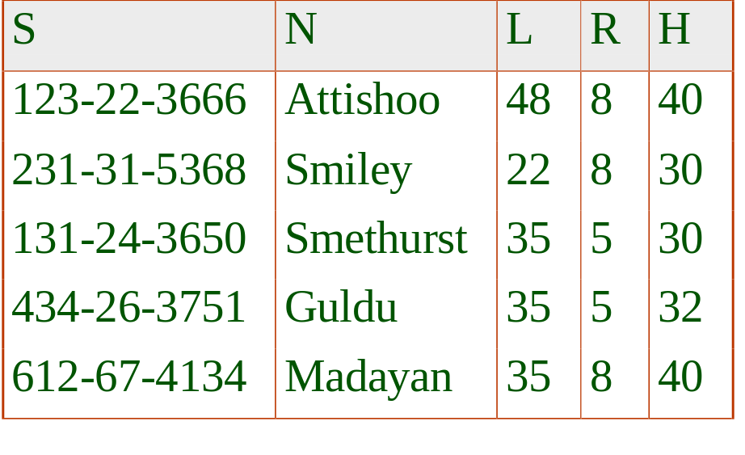
Same Example
Wages
Hourly_Emps2
Problems due to R W :
  Update anomaly: Can we change W in just the 1st tuple of SNLRWH?
  Insertion anomaly: What if we want to insert an employee and don’t know the hourly wage for his rating?
  Deletion anomaly: If we delete all employees with rating 5, we lose the information about the wage for rating 5!
Will 2 smaller tables be better?
Notes:
17

Slide 15
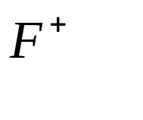

Reasoning About FDs
Given some FDs, we can usually infer additional FDs:
  ssn did, did lot implies ssn lot
An FD f is implied by a set of FDs F if f holds whenever all FDs in F hold.
  = closure of F is the set of all FDs that are implied by F.
Armstrong’s Axioms (X, Y, Z are sets of attributes):
  Reflexivity: If X Y, then Y X
  Augmentation: If X Y, then XZ YZ for any Z
  Transitivity: If X Y and Y Z, then X Z
These are sound and complete inference rules for FDs!
Notes:
19

Slide 16
Reasoning About FDs
Given some FDs, we can usually infer additional FDs:
  ssn did, did lot implies ssn lot
Notes:
19

Slide 17
Properties of FDs
Consider A, B, C, Z are sets of attributes
Armstrong’s Axioms:
Reflexive (also trivial FD): if A ⊇ B, then A → B
Transitive: if A → B, and B → C, then A → C
Augmentation: if A → B, then AZ → BZ
These are sound and complete inference rules for FDs!
Additional rules (that follow from AA):
Union: if A → B, A → C, then A → BC
Decomposition: if A → BC, then A → B, A → C

Slide 18
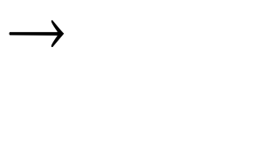

Reasoning About FDs (Contd.)
Couple of additional rules (that follow from AA):
  Union: If X Y and X Z, then X YZ
  Decomposition: If X YZ, then X Y and X Z
Example: Contracts(cid,sid,jid,did,pid,qty,value), and:
  C is the key: C CSJDPQV
  Project purchases each part using single contract: JP C
  Dept purchases at most one part from a supplier: SD P
JP C, C CSJDPQV imply JP CSJDPQV
SD P implies SDJ JP
SDJ JP, JP CSJDPQV imply SDJ CSJDPQV
Notes:
20

Slide 19
Example : Reasoning About FDs
Example: Contracts(cid,sid,jid,did,pid,qty,value), and:
  C is the key: C CSJDPQV
  Project purchases each part using single contract: JP C
  Dept purchases at most one part from a supplier: SD P
Inferences:
JP C, C CSJDPQV imply JP CSJDPQV
SD P implies SDJ JP
SDJ JP, JP CSJDPQV imply SDJ CSJDPQV
Notes:
20

Slide 20
Inferring FDs
What for ?
  Suppose we have a relation R (A, B, C)
  and functional dependencies : A → B, B → C, C → A
What is a key for R?
We can infer A → ABC, B → ABC, C → ABC.
Hence A, B, C are all keys.

Slide 21
Closure of FDs
An FD f is implied by a set of FDs F if f holds whenever all FDs in F hold.
  = closure of F is set of all FDs that are implied by F.
Computing closure of a set of FDs can be expensive.
  Size of closure is exponential in # attrs!
Notes:
19

Slide 22
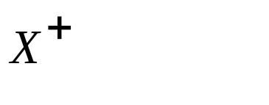
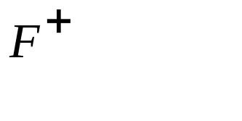


Reasoning About FDs (Contd.)
Computing the closure of a set of FDs can be expensive. (Size of closure is exponential in # attrs!)
Typically, we just want to check if a given FD X Y is in the closure of a set of FDs F. An efficient check:
  Compute attribute closure of X (denoted ) wrt F:
    Set of all attributes A such that X A is in
    There is a linear time algorithm to compute this.
  Check if Y is in
Does F = {A B, B C, C D E } imply A E?
  i.e, is A E in the closure ? Equivalently, is E in ?
Notes:
21

Slide 23
Reasoning About FDs (Contd.)
Instead of computing closure F+ of a set of FDs
  Too expensive
Typically, we just need to know if a given FD X Y is in closure of a set of FDs F.
Algorithm for efficient check:
  Compute attribute closure of X (denoted ) wrt F:
    Set of all attributes A such that X A is in
    There is a linear time algorithm to compute this.
  Check if Y is in X+ . If yes, then X → A in F+.
Notes:
21

Slide 24
Algorithm for Attribute Closure
Computing the closure of set of attributes {A1, A2, …, An}, denoted {A1, A2, …, An}⁺
  Let X = {A1, A2, …, An}
  If there exists a FD B1, B2, …, Bm → C, such that every Bi ∈ X, then X = X ∪ C
  Repeat step 2 until no more attributes can be added.
  Output {A1, A2, …, An}⁺ = X

Slide 25
Example : Inferring FDs
Given R (A, B, C), and FDs A → B, B → C, C → A,
What are possible keys for R ?
Compute the closure of attributes:
  {A}⁺ = {A, B, C}
  {B}⁺ = {A, B, C}
  {C}⁺ = {A, B, C}
So keys for R are <A>, <B>, <C>

Slide 26
Another Example : Inferring FDs
Consider R (A, B, C, D, E)
with FDs F = { A → B, B → C, CD → E }
does A → E hold ?
Rephrase as :
  Is A → E in the closure F+ ?
  Equivalently, is E in A+ ?
Let us compute {A}⁺
{A}⁺ = {A, B, C}
Conclude : E is not in A+, therefore A → E is false

Slide 27
Reasoning About FDs (Contd.)
Computing the closure of a set of FDs can be expensive. (Size of closure is exponential in # attrs!)
Typically, we just want to check if a given FD X Y is in the closure of a set of FDs F. An efficient check:
  Compute attribute closure of X (denoted ) wrt F:
    Set of all attributes A such that X A is in
    There is a linear time algorithm to compute this.
  Check if Y is in
Does F = {A B, B C, C D E } imply A E?
  i.e, is A E in the closure ? Equivalently, is E in ?
Notes:
21

Slide 28
Schema Refinement : Normal Forms
Question : How decide if any refinement of schema is needed ?
If a relation is in a certain normal form
  like BCNF, 3NF, etc.
then it is known that certain kinds of problems are avoided or at least minimized.
This can be used to help us decide whether to decompose the relation.
Notes:
22

Slide 29
Schema Refinement : Normal Forms
Role of FDs in detecting redundancy:
  Consider a relation R with 3 attributes, ABC.
  No FDs hold: There is no redundancy here.
  Given A B: Several tuples could have the same A value, and if so, they’ll all have the same B value!
Notes:
22

Slide 30

Normal Forms: BCNF
Boyce Codd Normal Form (BCNF):
  For every non-trivial FD X → A in R, X is a superkey of R
  Note : trivial FD means A X
Informally: R is in BCNF if the only non-trivial FDs that hold over R are key constraints.

Slide 31
BCNF example
SCI (student, course, instructor)
FDs:
student, course → instructor
instructor → course
Decomposition into 2 relations :
SI (student, instructor)
Instructor (instructor, course)

Slide 32
Is it in BCNF ?
Is the resulting schema in BCNF ?
For every non-trivial FD X → A in R, X is a superkey of R
SI
Instructor
student | instructor
Dave | P1
Dave | P2
instructor | course
P1 | DB 1
P2 | DB 1
FDs ?
student, course → instructor?
instructor → course

Slide 33
3NF - example
Lot (propNo, county, lotNum, area, price, taxRate)
Candidate key: <county, lotNum>
FDs:
county → taxRate
area → price
Decomposition:
Lot (propNo, county, lotNum, area, price)
County (county, taxRate)

Slide 34
3NF - example
Lot (propNo, county, lotNum, area, price)
County (county, taxRate)
Candidate key for Lot: <county, lotNum>
FDs:
county → taxRate
area → price
Decomposition:
Lot (propNo, county, lotNum, area)
County (county, taxRate)
Area (area, price)

Slide 35
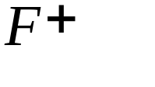
Third Normal Form (3NF)
Relation R with FDs F is in 3NF if, for all X A in
  A X (called a trivial FD), or
  X contains a key for R, or
  A is a part of some key for R.
Minimality of a key is crucial in this third condition!
Notes:
24

Slide 36
3NF and BCNF ?
If R is in BCNF, obviously R is in 3NF.
If R is in 3NF, R may not be in BCNF.
If R is in 3NF, some redundancy is possible.
3NF is a compromise used when BCNF not achievable, i.e., when no ``good’’ decomp exists or due to performance considerations
NOTE: Lossless-join, dependency-preserving decomposition of R into a collection of 3NF relations always possible.
Notes:
24

Slide 37
How get those Normal Forms?
Method:
  First, analyze relation and FDs
  Second, apply decomposition of R into smaller relations
Decomposition of R replaces R by two or more relations such that:
  Each new relation scheme contains a subset of attributes of R and
  Every attribute of R appears as an attribute of one of the new relations.
E.g., Decompose SNLRWH into SNLRH and RW.
Notes:
26

Slide 38

Example Decomposition
Decompositions should be used only when needed.
  SNLRWH has FDs S SNLRWH and R W
  Second FD causes violation of 3NF !
  Thus W values repeatedly associated with R values.
  Easiest way to fix this:
    to create a relation RW to store these associations, and to remove W from main schema:
    i.e., we decompose SNLRWH into SNLRH and RW
Notes:
27

Slide 39
Example Decomposition
The information to be stored consists of SNLRWH tuples.
If we just store the projections of these tuples onto SNLRH and RW, are there any potential problems that we should be aware of?
Notes:
27

Slide 40
Decomposing Relations
StudentProf
sNumber | sName | pNumber | pName
s1 | Dave | p1 | X
s2 | Greg | p2 | X
FDs: pNumber → pName
Student
Professor
sNumber | sName | pNumber
s1 | Dave | p1
s2 | Greg | p2
pNumber | pName
p1 | X
p2 | X
Generating spurious tuples ?

Slide 41
Decomposition: Lossless Join Property
Student
Professor
sNumber | sName | pName
S1 | Dave | X
S2 | Greg | X
pNumber | pName
p1 | X
p2 | X
FDs: pNumber → pName
Generating spurious tuples ?
StudentProf
sNumber | sName | pNumber | pName
s1 | Dave | p1 | X
s1 | Dave | p2 | X
s2 | Greg | p1 | X
s2 | Greg | p2 | X

Slide 42
Problems with Decompositions
Potential problems to consider:
  Given instances of decomposed relations, not possible to reconstruct corresponding instance of original relation!
    Fortunately, not in the SNLRWH example.
  Checking some dependencies may require joining the instances of the decomposed relations.
    Fortunately, not in the SNLRWH example.
  Some queries become more expensive.
    e.g., How much did sailor Joe earn? (salary = W*H)
Tradeoff: Must consider these issues vs. redundancy.
Notes:
28

Slide 43
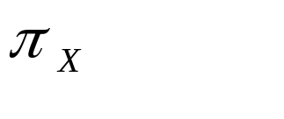
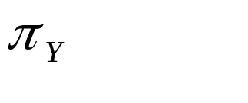


Lossless Join Decompositions
Decomposition of R into X and Y is lossless-join w.r.t. a set of FDs F if, for every instance r that satisfies F:
  (r) (r) = r
It is always true that r (r) (r)
  In general, the other direction does not hold!
  If it does, the decomposition is lossless-join.
Decomposition into 3 or more relations : Same idea
All decompositions used to deal with redundancy must be lossless!
Notes:
29

Slide 44
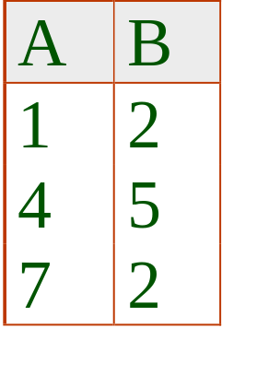
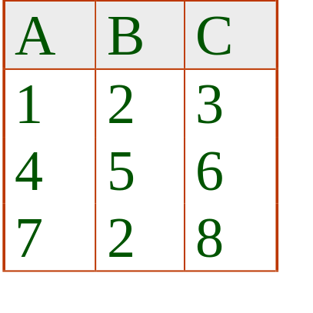
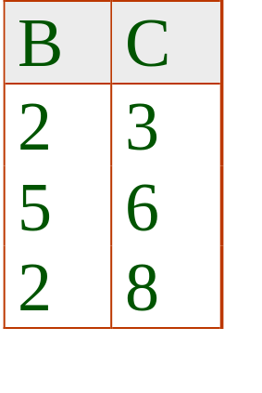


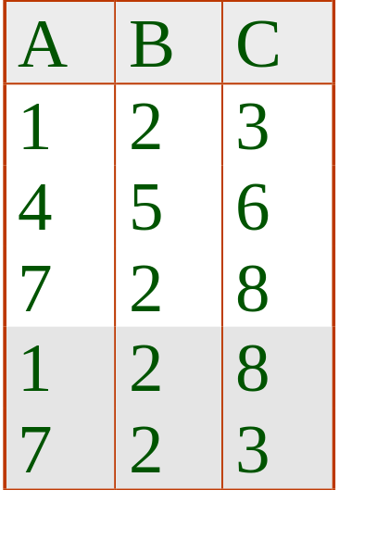
Lossless Join: Necessary & Sufficient !
The decomposition of R into X and Y is lossless-join wrt F if and only if the closure of F contains:
  X Y X, or
  X Y Y
In particular, the decomposition of R into UV and R - V is lossless-join if U V holds over R.
Notes:
30

Slide 45
Decomposition : Dependency Preserving ?
Consider CSJDPQV, C is key, JP C and SD P.
  Decomposition: CSJDQV and SDP
  Is it lossless ? Yes !
  Is it in BCNF ? Yes !
  Problem: Checking JP C requires a join!
Notes:
3

Slide 46
Dependency Preserving Decomposition
Property : Dependency preserving decomposition
Intuition :
  If R is decomposed into X, Y and Z, and we enforce the FDs that hold on X, on Y and on Z, then all FDs that were given to hold on R must also hold. (Avoids Problem (3).)
Notes:
3

Slide 47
Dependency Preserving
Projection of set of FDs F:
If R is decomposed into X, Y, ... then projection of F onto X (denoted F_{X} ) is the set of FDs U V in F⁺ (closure of F ) such that U, V are in X.
Notes:
3

Slide 48
Dependency Preserving Decomposition
Consider CSJDPQV, C is key, JP C and SD P.
  BCNF decomposition: CSJDQV and SDP
  Problem: Checking JP C requires a join!
Dependency preserving decomposition (Intuitive):
  If R is decomposed into X, Y and Z, and we enforce the FDs that hold on X, on Y and on Z, then all FDs that were given to hold on R must also hold. (Avoids Problem (3).)
Projection of set of FDs F: If R is decomposed into X, ... projection of F onto X (denoted F_{X} ) is the set of FDs U V in F⁺ (closure of F ) such that U, V are in X.
Notes:
3

Slide 49
Dependency Preserving Decompositions
Formal Definition :
  Decomposition of R into X and Y is dependency preserving if (F_{X} union F_{Y} ) ⁺ = F ⁺
Intuition Again:
  If we consider only dependencies in the closure F ⁺ that can be checked in X without considering Y, and in Y without considering X, these imply all dependencies in F ⁺.
Important to consider F ⁺, not F, in this definition:
  ABC, A B, B C, C A, decomposed into AB and BC.
  Is this dependency preserving?
  Is C A preserved ?
Notes:
4

Slide 50
Dependency Preserving Decompositions
Does dependency preserving imply lossless join?
  Example : ABC, A B, decomposed into AB and BC.
Does lossless join imply dependency preserving ?
  Example: We saw a BCNF example earlier for that.
Notes:
4

Slide 51
Algorithm : Decomposition into BCNF
Consider relation R with FDs F. If X Y violates BCNF, decompose R into R - Y and XY.
Repeated application of this idea will result in:
    relations that are in BCNF;
    lossless join decomposition,
    and guaranteed to terminate.
Note: In general, several dependencies may cause violation of BCNF. The order in which we ``deal with’’ them could lead to very different sets of relations!
Notes:
5

Slide 52
Normalization Step
Consider relation R with set of attributes A_{R}. Consider a FD A → B (such that no other attribute in (A_{R} – A – B) is functionally determined by A).
If A is not a superkey for R, we may decompose R as:
  Create R’ (A_{R} – B)
  Create R’’ with attributes A ∪ B
  Key for R’’ = A

Slide 53

Example of Decomposition into BCNF
Example :
  CSJDPQV, key C, JP C, SD P, J S
  To deal with SD P,
  decompose into SDP, CSJDQV.
  To deal with J S,
  decompose CSJDQV into JS and CJDQV
Notes:
5

Slide 54
Algorithm : Decomposition into BCNF
Example :
  CSJDPQV, key C, JP C, SD P, J S
  To deal with SD P,
  decompose into SDP, CSJDQV.
  To deal with J S,
  decompose CSJDQV into JS and CJDQV
  Result : (not unique!)
  Decomposition of CSJDQV into SDP, JS and CJDQV
  Is above decomposition lossless?
  Is above decompositon dependency-preserving ?
Notes:
5

Slide 55
BCNF and Dependency Preservation
In general, a dependency preserving decomposition into BCNF may not exist !
  Example : CSZ, CS Z, Z C
  Not in BCNF.
  Can’t decompose while preserving 1st FD.
Notes:
6

Slide 56
BCNF example
SCI (student, course, instructor)
FDs:
student, course → instructor
instructor → course
Decomposition into 2 relations :
1. All attributes besides RHS
SI (student, instructor)
2. All attributes in the FD
Instructor (instructor, course)

Slide 57
Is it in BCNF ?
Is the resulting schema in BCNF ?
SI
Instructor
student | instructor
Dave | P1
Dave | P2
instructor | course
P1 | DB 1
P2 | DB 1
FDs ?
student, course → instructor
instructor → course

Slide 58
Dependency Preservation
BCNF does not necessarily preserve FDs.
SI
Instructor
student | instructor
Dave | P1
Dave | P2
instructor | course
P1 | DB 1
P2 | DB 1
SCI (from SI and Instructor)
student | instructor | course
Dave | P1 | DB 1
Dave | P2 | DB 1
SCI violates the FD
student, course → instructor

Slide 59
Decomposition into 3NF
What about 3NF instead ?
Notes:
7

Slide 60
Algorithm : Decomposition into 3NF
Obviously, the algorithm for lossless join decomp into BCNF can be used to obtain a lossless join decomp into 3NF (typically, can stop earlier).
To ensure dependency preservation, one idea:
  If X Y is not preserved, add relation XY.
  Problem is that XY may violate 3NF! e.g., consider the addition of CJP to `preserve’ JP C. What if we also have J C ?
Refinement: Instead of the given set of FDs F, use a minimal cover for F.
Notes:
7

Slide 61
Minimal Cover for a Set of FDs
Minimal cover G for a set of FDs F:
  Closure of F = closure of G.
  Right hand side of each FD in G is a single attribute.
  If we modify G by deleting a FD or by deleting attributes from an FD in G, the closure changes.
Intuition: every FD in G is needed, and ``as small as possible’’ in order to get the same closure as F.
Example : If both J → C and JP → C, then only keep the first one.
Notes:
8

Slide 62
Minimal Cover for a Set of FDs
Theorem :
  Use minimum cover of FD+ in decomposition guarantees that the decomposition is Lossless-Join, Dep. Pres. Decomposition
Example :
Given :
  A → B, ABCD → E, EF → GH, ACDF → EG
Then the minimal cover is:
  A → B, ACD → E, EF → G and EF → H
Notes:
8

Slide 63
Algorithm for Minimal Cover
Decompose FD into one attribute on RHS
Minimize left side of each FD
  Check each attribute on LHS to see if deleted while still preserving the equivalence to F+.
Delete redundant FDs.
Note: Several minimal covers may exist.
Notes:
8

Slide 64
Minimal Cover for a Set of FDs
Example :
Given :
  A → B, ABCD → E, EF → GH, ACDF → EG
Then the minimal cover is:
  A → B, ACD → E, EF → G and EF → H
Notes:
8

Slide 65
3NF Decomposition Algorithm
Compute minimal cover G of F
Decompose R using minimal cover G of FD into lossless decomposition of R.
  Each Ri is in 3NF
  Fi is projection of F onto Ri
Identify dependencies in G not preserved now, X → A
Create relation XA :
  New relation XA preserves X → A
  X is key of XA, because G is minimal cover. Hence no Y subset X exists, with Y → A
Notes:
8

Slide 66
Refining an ER Diagram
1st diagram translated: Workers(S,N,L,D,S) Departments(D,M,B)
  Lots associated with workers.
Suppose all workers in a dept are assigned the same lot: D L
Redundancy; fixed by: Workers2(S,N,D,S) Dept_Lots(D,L)
Can fine-tune this: Workers2(S,N,D,S) Departments(D,M,B,L)
Before:
since
name
dname
ssn
lot
did
budget
Employees
Works_In
Departments
After:
budget
since
name
dname
ssn
did
lot
Employees
Works_In
Departments
Notes:
18

Slide 67
Summary of Schema Refinement
Step 1: BCNF is a good form for relation
  If a relation is in BCNF, it is free of redundancies that can be detected using FDs.
Step 2 : If a relation is not in BCNF, we can try to decompose it into a collection of BCNF relations.
Step 3: If a lossless-join, dependency preserving decomposition into BCNF is not possible (or unsuitable, given typical queries), then consider decomposition into 3NF.
Note: Decompositions should be carried out and/or re-examined while keeping performance requirements in mind.
Notes:
9

